Slide 1
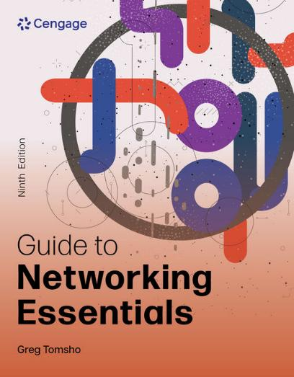
Guide to Networking Essentials, 9e
Chapter 10: Wide Area Networking and Cloud Computing
.

Slide 2
Chapter Objectives
By the end of this chapter, you should be able to:
Describe the fundamentals of WAN operation and devices
Discuss the methods used to connect to WANs
Configure and describe remote access protocols
Describe the three cloud computing models

Slide 3
Wide Area Network Fundamentals (1 of 2)
Internetworks and WANs can be described as two or more LANs connected together
The main difference between internetworks and WANs is the distance between the LANs being connected
They also differ in two other areas:
WANs use the services of carriers or service providers (phone companies and ISPs) for network connections
WANs use serial communication that can span miles compared to LAN technologies that span distances measured in hundreds of meters

Slide 4
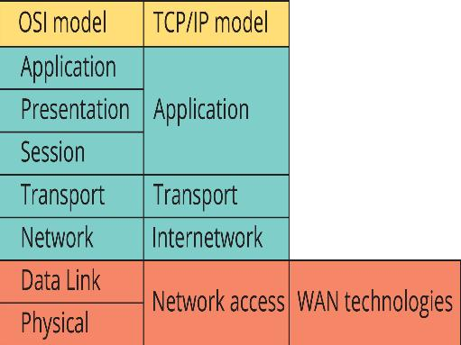
Wide Area Network Fundamentals (2 of 2)
Figure 10-1 WAN technologies operate at the lower layers

Slide 5
WAN Devices (1 of 5)
WANs operate at the Data Link and Physical layers (Layers 2 and 1) of the OSI model
The following are types of devices likely to be used in WANs for media access, signal transmission, and reception and to connect a WAN to a LAN:
Modems
Channel service units/data service units
Routers

Slide 6
WAN Devices (2 of 5)
A modem is a device that allows a computer (which works with digital signals) to communicate over lines that use analog signals
A digital signal is a series of binary 1s and 0s represented by some type of signal that has two possible states (0v or 5v)
An analog signal varies over time continually and smoothly (transitions from 0v to 5v)
Modems used in WAN communications are closely associated with dial-up communication over the public switched telephone network (PSTN)
Broadband networks have mostly supplanted dial-up Internet access

Slide 7
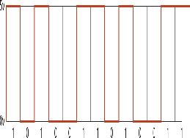
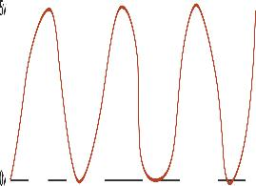
WAN Devices (3 of 5)
Figure 10-2 A digital signal represented as a square wave
Figure 10-3 An analog signal varies continually

Slide 8
WAN Devices (4 of 5)
A channel service unit/data service unit (CSU/DSU) creates a digital connection between a LAN device (router) and the WAN link
The WAN link is usually a T-carrier technology, such as a T1 or T3
A CSU/DSU performs similar to a modem, except all signals are digital
A router is responsible for getting packets from one network to another
In a WAN, it is usually the device connecting a LAN to the WAN service provider via a modem or CSU/DSU

Slide 9
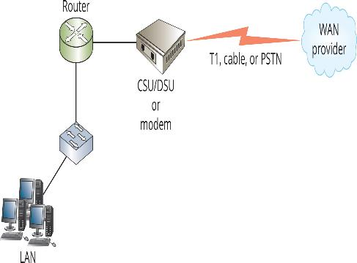
WAN Devices (5 of 5)
Figure 10-4 A typical LAN-to-WAN connection

Slide 10
WAN Connection Methods
Many WAN technologies are available that differ in speed, level of security and reliability, and cost
The following are the four most common connection methods:
Circuit-switched
Leased line
Packet-switched
VPN over the Internet
A network administrator must weigh each method’s cost, speed, reliability, level of security, and available underlying technologies

Slide 11
Circuit-Switched WANs
A circuit-switched WAN creates a temporary dedicated connection between sender and receiver on demand
Analog example: a phone line connection from the PSTN, also known as plain old telephone service (POTS)
Digital example: Integrated Services Digital Network (ISDN)
Both were phased out in the US in 2022
ISDN is still in use in some parts of the world where faster technologies are unavailable or too expensive

Slide 12
Leased Lines (1 of 6)
A leased line provides a dedicated point-to-point connection from the customer’s LAN through the provider’s network and the destination network
It provides permanent, secure, and dedicated bandwidth
Leased lines are expensive and should be considered in the following circumstances:
When high quality, 24/7 access is needed
For mission-critical applications
When fast upstream and downstream communication is required

Slide 13
Leased Lines (2 of 6)
Typical T-carrier lines are T1 and T3 that operate at 1.544 Mbps and 44Mbps, respectively
They are derived from multiple 64 Kbps channels, making a T1 connection a grouping of 24 channels and a T3 connection a grouping of 672 channels
A T-carrier line uses a signaling method called time division multiplexing (TDM), which allocates a time slot for each channel
If a portion of a T-carrier line is used for one purpose and a different portion for another purpose, the line has been fractionalized
Multiplexing enables several communication streams to travel simultaneously over the same cable segment

Slide 14
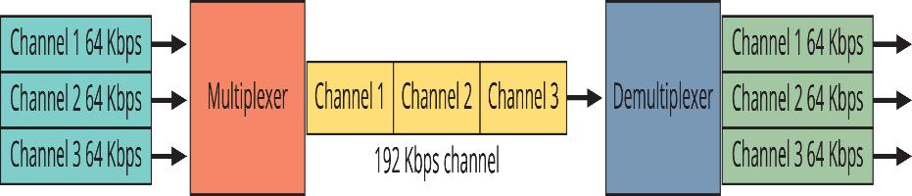
Leased Lines (3 of 6)
Figure 10-5 Multiplexing/demultiplexing

Slide 15
Leased Lines (4 of 6)
T-carrier lines require a CSU/DSU at each end of the link to convert the signals used by the T-carrier line into signals used by the LAN
T-carriers can use shielded twisted-pair cabling for carrying up to T1 speeds
Multiple T1s or T3s require coaxial or fiber-optic cabling and can also be carried via microwave and satellite transmitters
For a more advanced connection, T1 lines can be connected to a smart jack, which is a network interface device (NID) that serves as a termination point for a T1 connection

Slide 16
Leased Lines (5 of 6)
Synchronous Optical Network (SONET) is a flexible, highly fault-tolerant technology that can operate at different capacities over fiber cabling
Typical SONET rates are OC-3 (155 Mbps), OC-12 (622 Mbps), OC-48 (almost 2.5 Gbps), OC-192, and OC-768 (used by large ISPs)
SONET networks can carry traffic from a variety of other network types, such as T-carrier and ATM
SONET can be arranged in a variety of physical topologies, including point-to-point, point-to-multipoint, star, and ring
SONET uses a dual-ring topology (like FDDI), making it very fault-tolerant

Slide 17
Leased Lines (6 of 6)
Point-to-Point Protocol (PPP) operates at the Data Link and Network layers and is used to carry a variety of protocols over different types of network connections
Two protocols that are integral to PPP include the following:
Link Control Protocol (LCP)—sets up the PPP connection, defines communication parameters/authentication protocols and terminates the link
Network Control Protocol (NCP)—encapsulates higher-layer protocols and provides services such as dynamic IP addressing

Slide 18
Packet-Switched WANs (1 of 7)
A packet-switched WAN doesn’t create a dedicated connection between sender and receiver
Data is transmitted in frames or packets
Each packet is transmitted through the provider’s network independently and bandwidth is shared with your provider’s other customers
The most common packet-switched networks are:
X.25, Frame Relay, ATM, and MPLS

Slide 19
Packet-Switched WANs (2 of 7)
A virtual circuit is a logical connection created between two devices in a shared network
No single cable exists between the two endpoints, instead a virtual circuit maps a path through switches between two points
The pathway is created after sender and receiver agree on bandwidth requirements and request a pathway
Switched virtual circuit (SVCs) are established when needed and then terminated when the transmission is completed
Permanent virtual circuit (PVCs) a pathway between two communication points is established as a permanent logical connection

Slide 20
Packet-Switched WANs (3 of 7)
X.25 is a packet-switching technology developed in the 1970s running over older copper phone lines
X.25 networks offer both SVCs and PVCs, although not all X.25 providers offer PVCs
Earlier X.25 could only operate at 64 Kbps
A 1992 specification revision improved the maximum throughput of X.25 to 2 Mbps but the new version was not widely deployed
Even though X.25 offers reliable and error-free communications, this technology has been largely replaced by other higher-speed technologies

Slide 21
Packet-Switched WANs (4 of 7)
Frame Relay is a PVC packet-switching technology that offers WAN communication over a fast, reliable digital link
The frame relay technology can maintain transmission rates from 64 Kbps to 44 Mbps (T3 speed)
Frame relay allows customers to specify the bandwidth needed
Charges depend on the PVC’s bandwidth allocation (known as Committed Information Rate—CIR)
A frame relay connection is established by using a pair of CSU/DSUs with a router or bridge at each end to direct traffic on and off the WAN link

Slide 22
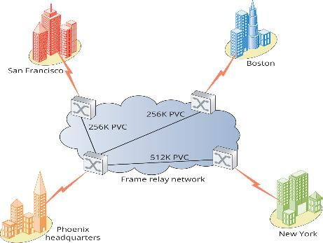
Packet-Switched WANs (5 of 7)
Figure 10-7 A Frame Relay network

Slide 23
Packet-Switched WANs (6 of 7)
Asynchronous Transfer Mode (ATM) is a high-speed network technology designed for both LAN and WAN use
ATM bandwidth can be as low as a few Mbps up to 622 Mbps, but the most common speed is 155 Mbps (an OC-3 SONET connection)
ATM is a cell-based packet switching technology
Cells are of a fixed length, which can be switched more efficiently than variable length packets
ATM is used for the backbone and infrastructure in large companies
ATM is best suited for LAN applications in which voice, data, and time-sensitive information travel on the same media

Slide 24
Packet-Switched WANs (7 of 7)
Multiprotocol Label Switching (MPLS) runs over ATM, frame relay, SONET, and even Ethernet
MPLS creates a connection-oriented virtual circuit using labels assigned to each packet
The label is used to make packet-forwarding decisions within the MPLS network, making it unnecessary to view the contents of the packet
MPLS is capable of supporting different Layer 3 protocols, and it is currently used exclusively in IP networks, supporting both IPv4 and IPv6
MPLS simplifies VPN deployment in large, multisite VPN applications

Slide 25
Ethernet WANs
Part 2
Many service providers offer Ethernet WANs over fiber-optic cabling
Two of the common names for this technology are:
Metropolitan Ethernet (Metro Ethernet or MetroE) and Ethernet over MPLS (EoMPLS)
Other Ethernet WAN technologies include Ethernet over software-defined WAN (SD-WAN) and Ethernet over Fiber
They have largely replaced frame relay and ATM
A typical Ethernet WAN link can operate at 1 Gbps and range in distance from 5 km to over 70 km

Slide 26
WANs over the Internet
Using VPN connections over inexpensive Internet connections is a popular WAN alternative
VPNs offer the following advantages over other WAN methods:
Inexpensive
Convenience
Security
Flexibility
A drawback is the unpredictable nature of the Internet

Slide 27
WAN Equipment (1 of 3)
Customer Premises Equipment (CPE) is the equipment at the customer site and usually includes routers, modems, and CSU/DSUs
The customer might own or lease the equipment from the provider
The demarcation point (demarc) is the point at which the CPE ends and the provider’s responsibility begins (where the WAN connection is made)
The provider location nearest the customer site is usually referred to as the central office (CO)
The connection between the demarcation point and the CO is called the local loop or last mile

Slide 28
WAN Equipment (2 of 3)
The CPE must be able to send data in the correct format to the connection that makes up the local loop
The device that sends data to the local loop is called the data circuit-terminating equipment (DCE) and the CSU/DSU or modem is called the “DCE device”
The device that passes data from the customer LAN to the DCE is called the data terminal equipment (DTE), which is typically the router or bridge that has one connection to the customer LAN and another connection to the DCE that makes the WAN connection

Slide 29
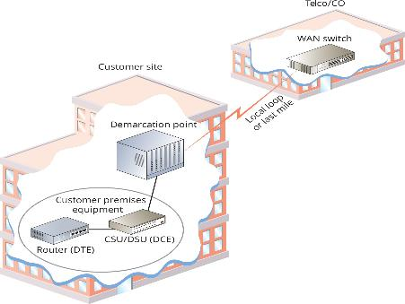
WAN Equipment (3 of 3)
Figure 10-8 A WAN connection showing the CPE, demarcation point, and local loop

Slide 30
Wireless WAN Technologies
Wireless WANs are used for last-mile communication where wired WAN technologies are not available or for mobile Internet connections
The following are common Wireless WAN technologies:
802.16 WiMAX—fixed WiMAX delivers up to 70 Mbps at distances up to 30 miles
LTE (Long Term Evolution)—all major cell phone carriers use LTE for smartphone data service
Satellite—requires a dish antenna and can deliver up to 100 Mbps download and 10 Mbps upload

Slide 31
Knowledge Check Activity 10-1
Which of the following WAN connection methods provides a dedicated point-to-point connection from the customer’s LAN through the provider’s network and to the destination network?
a. VPN
b. Packet-switched network
c. Metro Ethernet
d. Leased line

Slide 32
Knowledge Check Activity 10-1: Answer
Which of the following WAN connection methods provides a dedicated point-to-point connection from the customer’s LAN through the provider’s network and to the destination network?
Answer: d. Leased line
Explanation: A leased line provides a dedicated point-to-point connection from the customer’s LAN through the provider’s network and to the destination network. It provides permanent, secure, and dedicated bandwidth that’s limited only by the provider’s technology and how much the customer is willing to spend. In essence, customers rent the network connection.

Slide 33
Remote Access Networking (1 of 2)
Windows Server includes the Routing and Remote Access feature (RRAS), which supports both dial-up remote access and VPN remote access
Most client OSs can create dial-up or VPN network connections to a remote access server
After the remote access connection is established, the remotely connected computer acts as though it were connected directly to the network

Slide 34
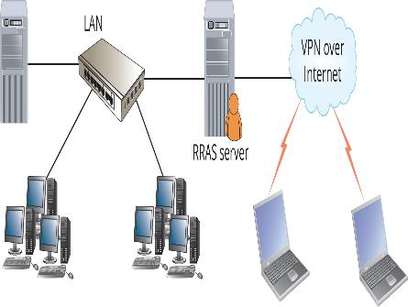
Remote Access Networking (2 of 2)
Figure 10-9 Windows Server provides remote connectivity to clients

Slide 35
Making a VPN Connection in Windows (1 of 3)
In Windows, you create a new VPN connection in the Network & Internet settings by selecting VPN and then Add a VPN connection (see Figure 10-10)
In the next window (see Figure 10-11), you specify the VPN provider, a name for the connection, and the Server name or address
You can also specify the VPN type
If you leave the option as Automatic, Windows will try to use each protocol until a connection is made
Finally, specify the type of credentials you will use to sign in to the VPN server

Slide 36
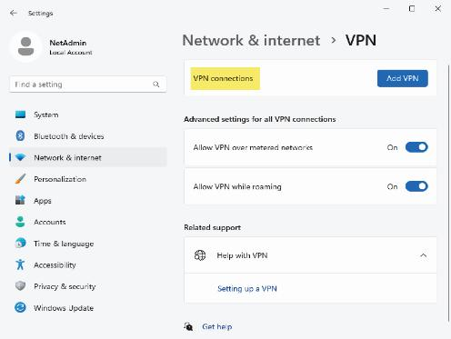
Making a VPN Connection in Windows (2 of 3)
Figure 10-10 Adding a VPN connection

Slide 37
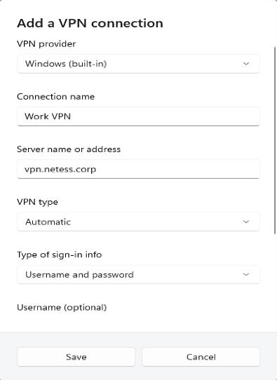
Making a VPN Connection in Windows (3 of 3)
Figure 10-11 Specifying VPN connection information

Slide 38
Remote Access Networking via the Web (1 of 2)
Another remote access model is remote control of your desktop via a Web browser
A client component is installed on your computer and then logon to the online service which connects you
These services use authentication and encryption to maintain a secure connection
Microsoft offers Remote Desktop Gateway
Users use the standard Remote Desktop Protocol (RDP) client to access their desktops

Slide 39
Remote Access Networking via the Web (2 of 2)
Another popular method for accessing remote network resources is connecting to a remote virtual machine (VM)
Cloud providers such as Microsoft Azure, Google Cloud, and Amazon Web Services provide this type of service
The remote VM’s desktop interface can be accessed using protocols such as RDP and virtual network computing (VNC) using RDP or VNC client
This type of service is referred to as virtual desktop infrastructure (VDI) and is part of a cloud computing paradigm called infrastructure as a service (IaaS) or desktop as a service (DaaS)

Slide 40
Cloud Computing (1 of 2)
Cloud computing is a networking model in which data, applications, and processing power are managed by servers on the Internet
Users of these resources pay for what they use rather than for the equipment and software needed to provide the resources
Benefits of cloud computing:
Reduced physical plant costs
Reduced upfront costs
Reduced personnel costs

Slide 41
Cloud Computing (2 of 2)
The following are the three main categories of cloud computing:
Software as a service
Platform as a service
Infrastructure as a service
The phrase “as a service” means the resource resides on another server or network than the one using the resource

Slide 42
Software as a Service
Software as a service (SaaS) is also called “hosted applications” or “on-demand applications”
The best-known examples are Google Apps and Microsoft Office 365
SaaS is usually offered as a subscription based on the number of users
Customers can take advantage of new software editions much faster
SaaS is available anywhere the customer has a connection to the Internet

Slide 43
Platform as a Service
Platform as a service (PaaS) is also called “hosted platform” and is similar to SaaS, but the customer develops applications with the service provider’s tool and infrastructure
Developers who use PaaS can take advantage of many of the same benefits as users of SaaS
In addition, developers can deploy an application immediately to customers who access it as a hosted application
The most common PaaS products are Salesforce.com’s Apex, Azure for Windows, Google’s AppEngine, AWS’s Elastic Beanstalk, and Engine Yard for Ruby on Rails

Slide 44
Infrastructure as a Service
Infrastructure as a service (IaaS) is also called “hosted infrastructure” and it allows a company to use storage or entire virtual servers
If a customer needs another terabyte of storage space, they can pay for the space without worrying about how that space is actually provided
If a customer needs another server, they pay for the amount of processing and storage the additional server actually requires
Customers rent the resources they are using but are still responsible for application installation and upgrade
Companies can “upgrade” to the latest OSs and desktop applications by using virtualized desktops through their IaaS providers

Slide 45
Private Cloud versus Public Cloud
When a company delivers cloud services to their own employees through the use of virtualization technologies it is known as private cloud services
Examples of virtualization technologies are VMware and Microsoft Hyper-V
Public cloud services are cloud services delivered by a third-party provider
In a hybrid cloud infrastructure, the organization maintains an on-premises datacenter that is connected to an IaaS provider to augment the on-premises resources

Slide 46
Knowledge Check Activity 10-2
Which “as a service” model allows customers to develop applications using the service provider’s tools and infrastructure?
a. SaaS
b. PaaS
c. IaaS
d. TaaS

Slide 47
Knowledge Check Activity 10-2: Answer
Which “as a service” model allows customers to develop applications using the service provider’s tools and infrastructure?
Answer: b. PaaS
Explanation: Platform as a service (PaaS)—also called “hosted platform”—has some similarities to SaaS, but the customer develops applications with the service provider’s tools and infrastructure. After applications are developed, they can be delivered to the customer’s users from the provider’s servers. This setup differs from SaaS, in which the service provider owns the applications delivered to users; with PaaS, the customer develops and owns the application and then delivers it to a third party.

Slide 48
Self Assessment
Describe the differences between internetworks and WANs.
Compare the different categories of cloud computing. Describe the difference between a private cloud, public cloud, and a hybrid cloud infrastructure.

Slide 49
Summary
Now that the lesson has ended, you should be able to:
Describe the fundamentals of WAN operation and devices
Discuss the methods used to connect to WANs
Configure and describe remote access protocols
Describe the three cloud computing models

